Slide 1




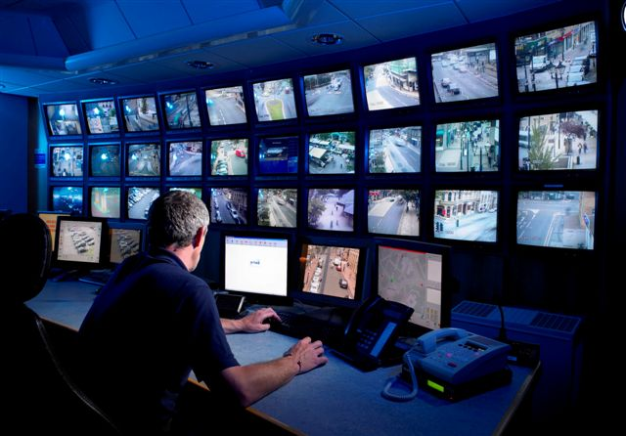





Electro
Vigilant Solution
Total Security
8637550552, 9163617680
Live view is directly sent to the destine flats to make the operation smooth and easy.
electrovigilantsolution@gmail.com
96, Baburam Ghosh Rd,
Ashoke Nagar,
Tollygunge,
Kolkata - 40
Assess through card is maintained for flat owners to avoid any mess and produce a easy way to get inside the main entrance of the flat.
2021
Any of the visitor can directly talk to the flat owner to confirm his identity before going inside.
Exclusively For
The total system is backed up with high end security to ensure 99% security from any unwanted incident.
Apartments
In this age of progress and technology security becomes an absolute necessity element to maintain a standard model of life and fulfillment of basic need.
Wisdom is Prioritizing
Security
For these our apartments becomes
a vulnerable spot which needs our . special attentions. That’s why we . have come up with a solution to . counter all your security needs
. in one go.
This is a upgraded version with touchless facility brought to you in the present time to ensure that properties built by you are better and secured than the market offers.

